Slide 1


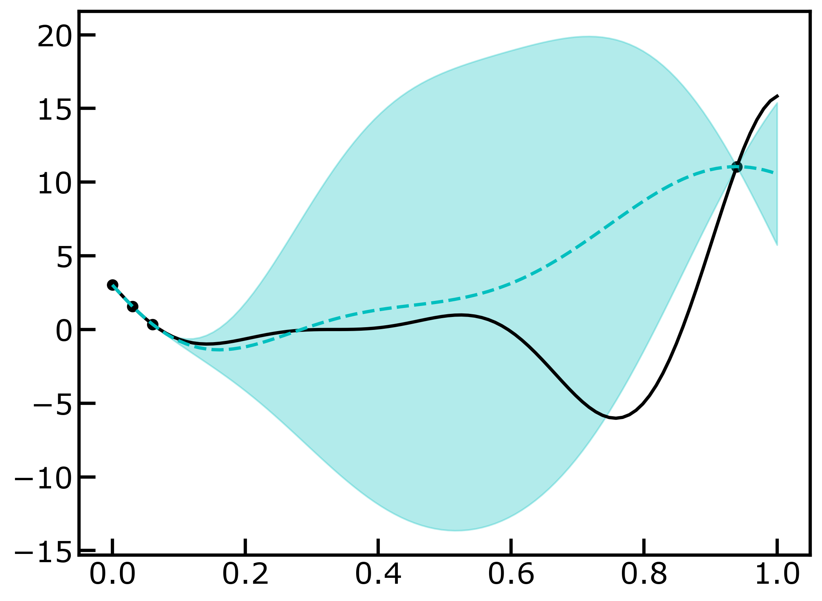
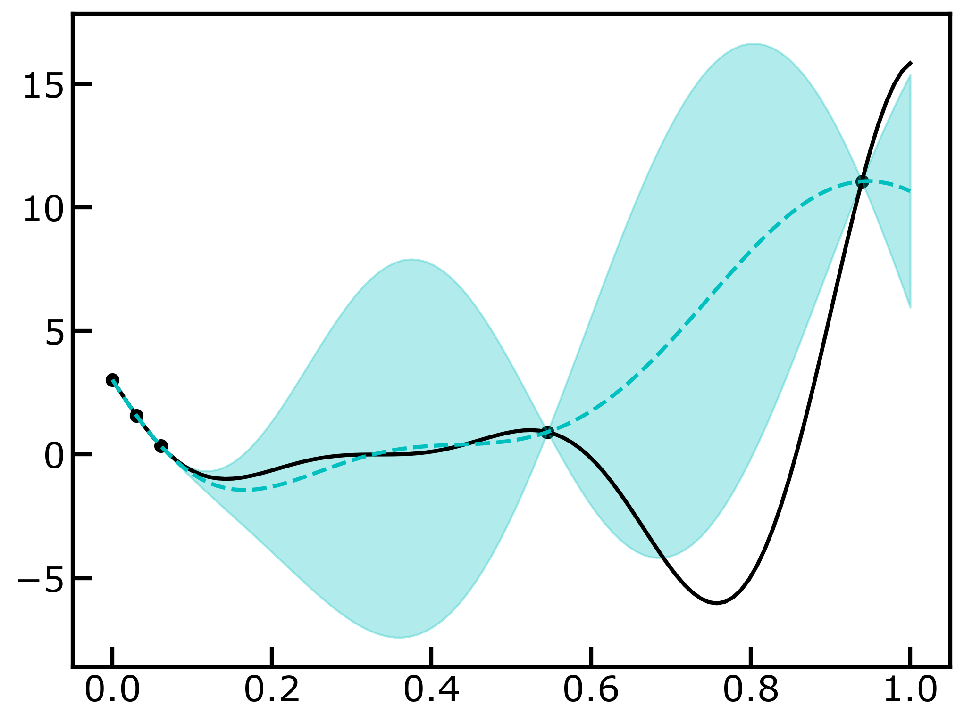

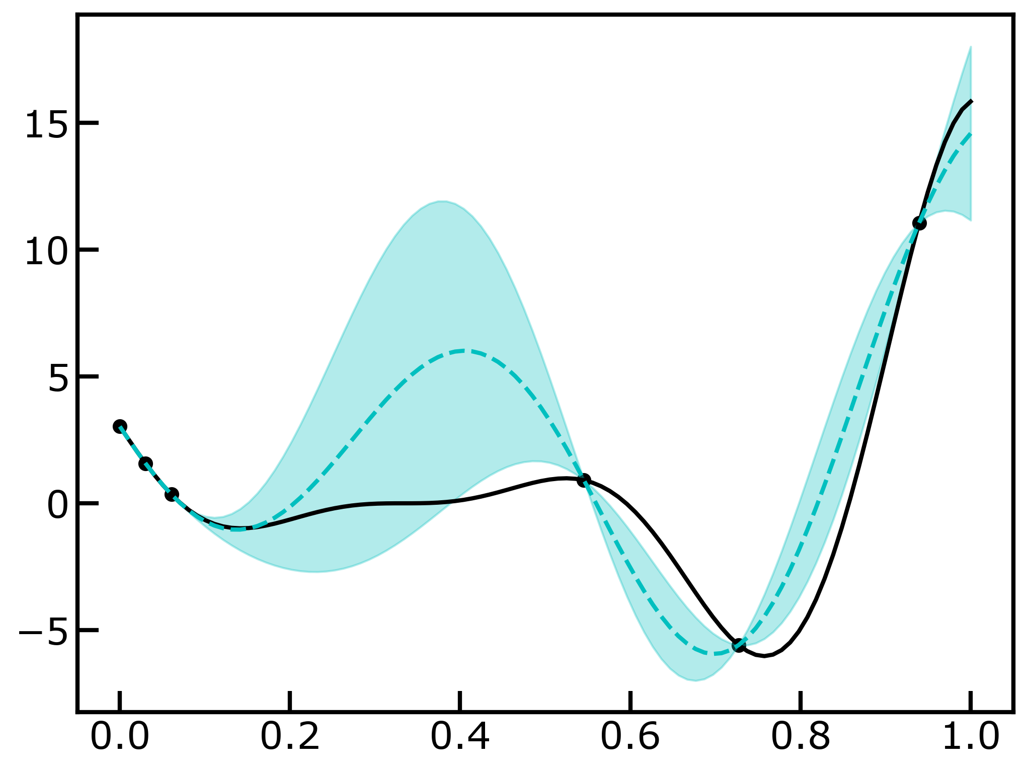


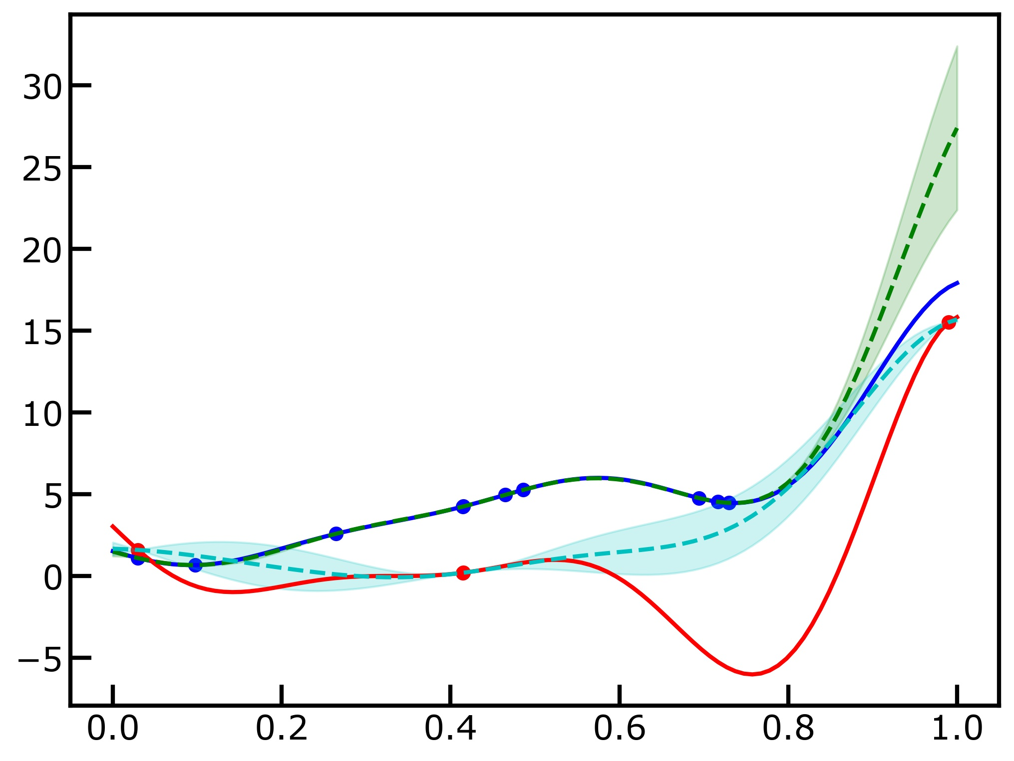
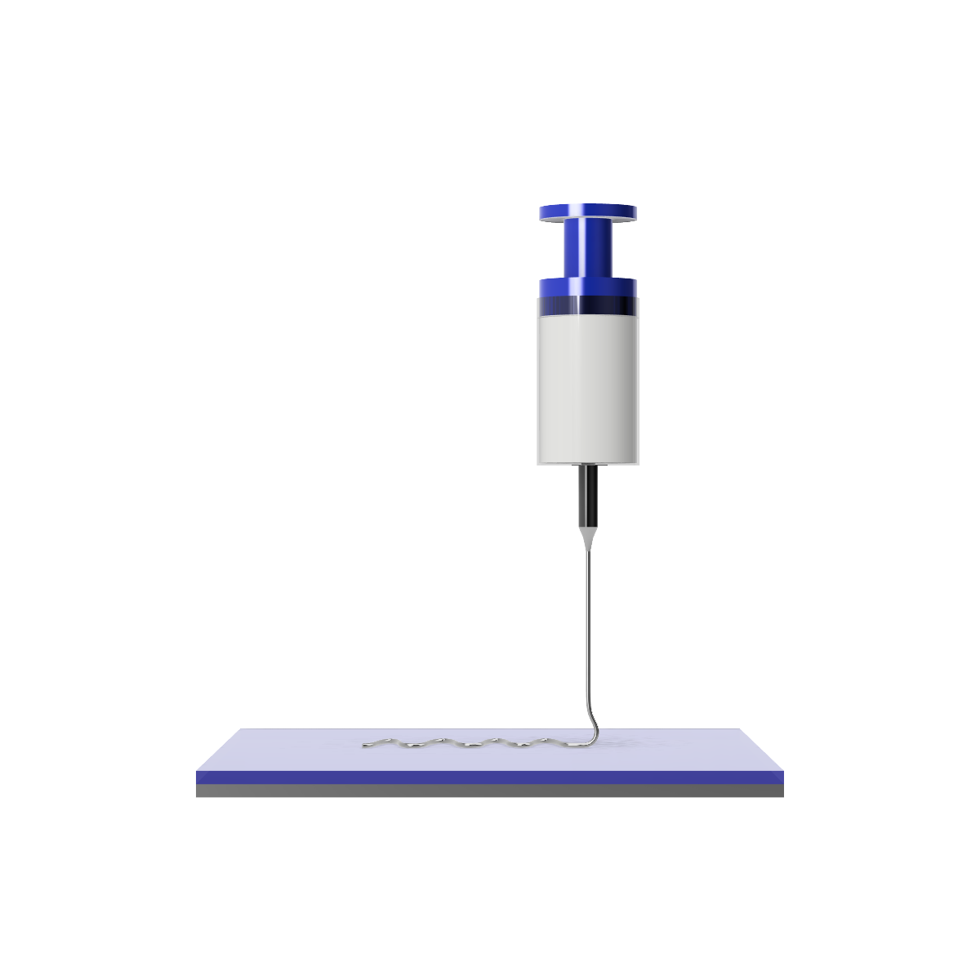
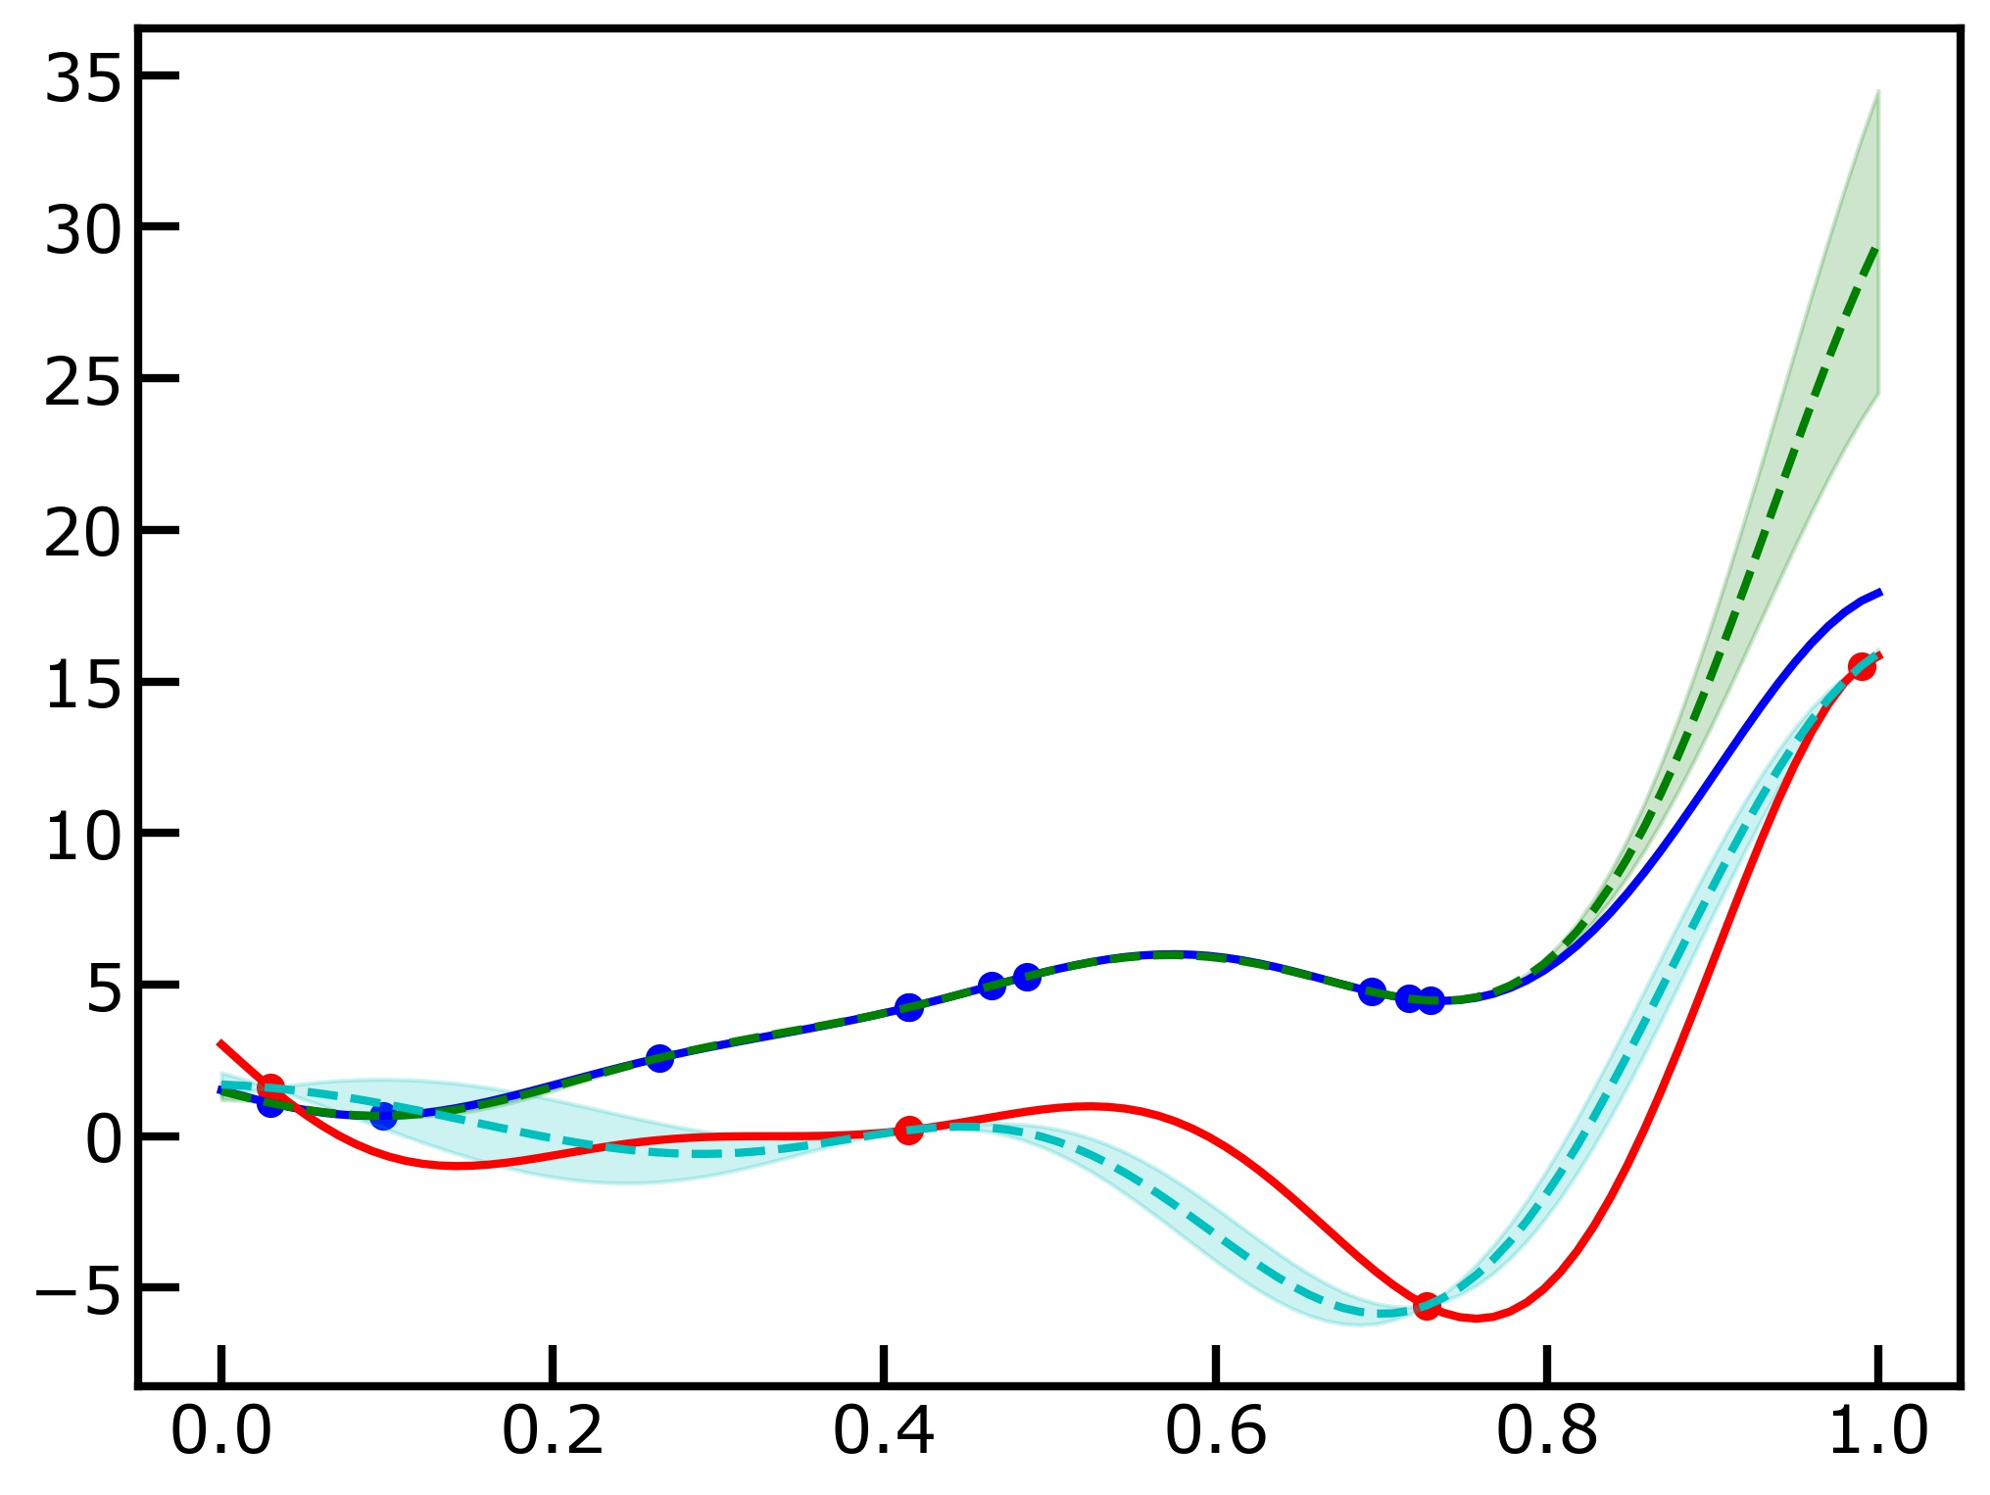

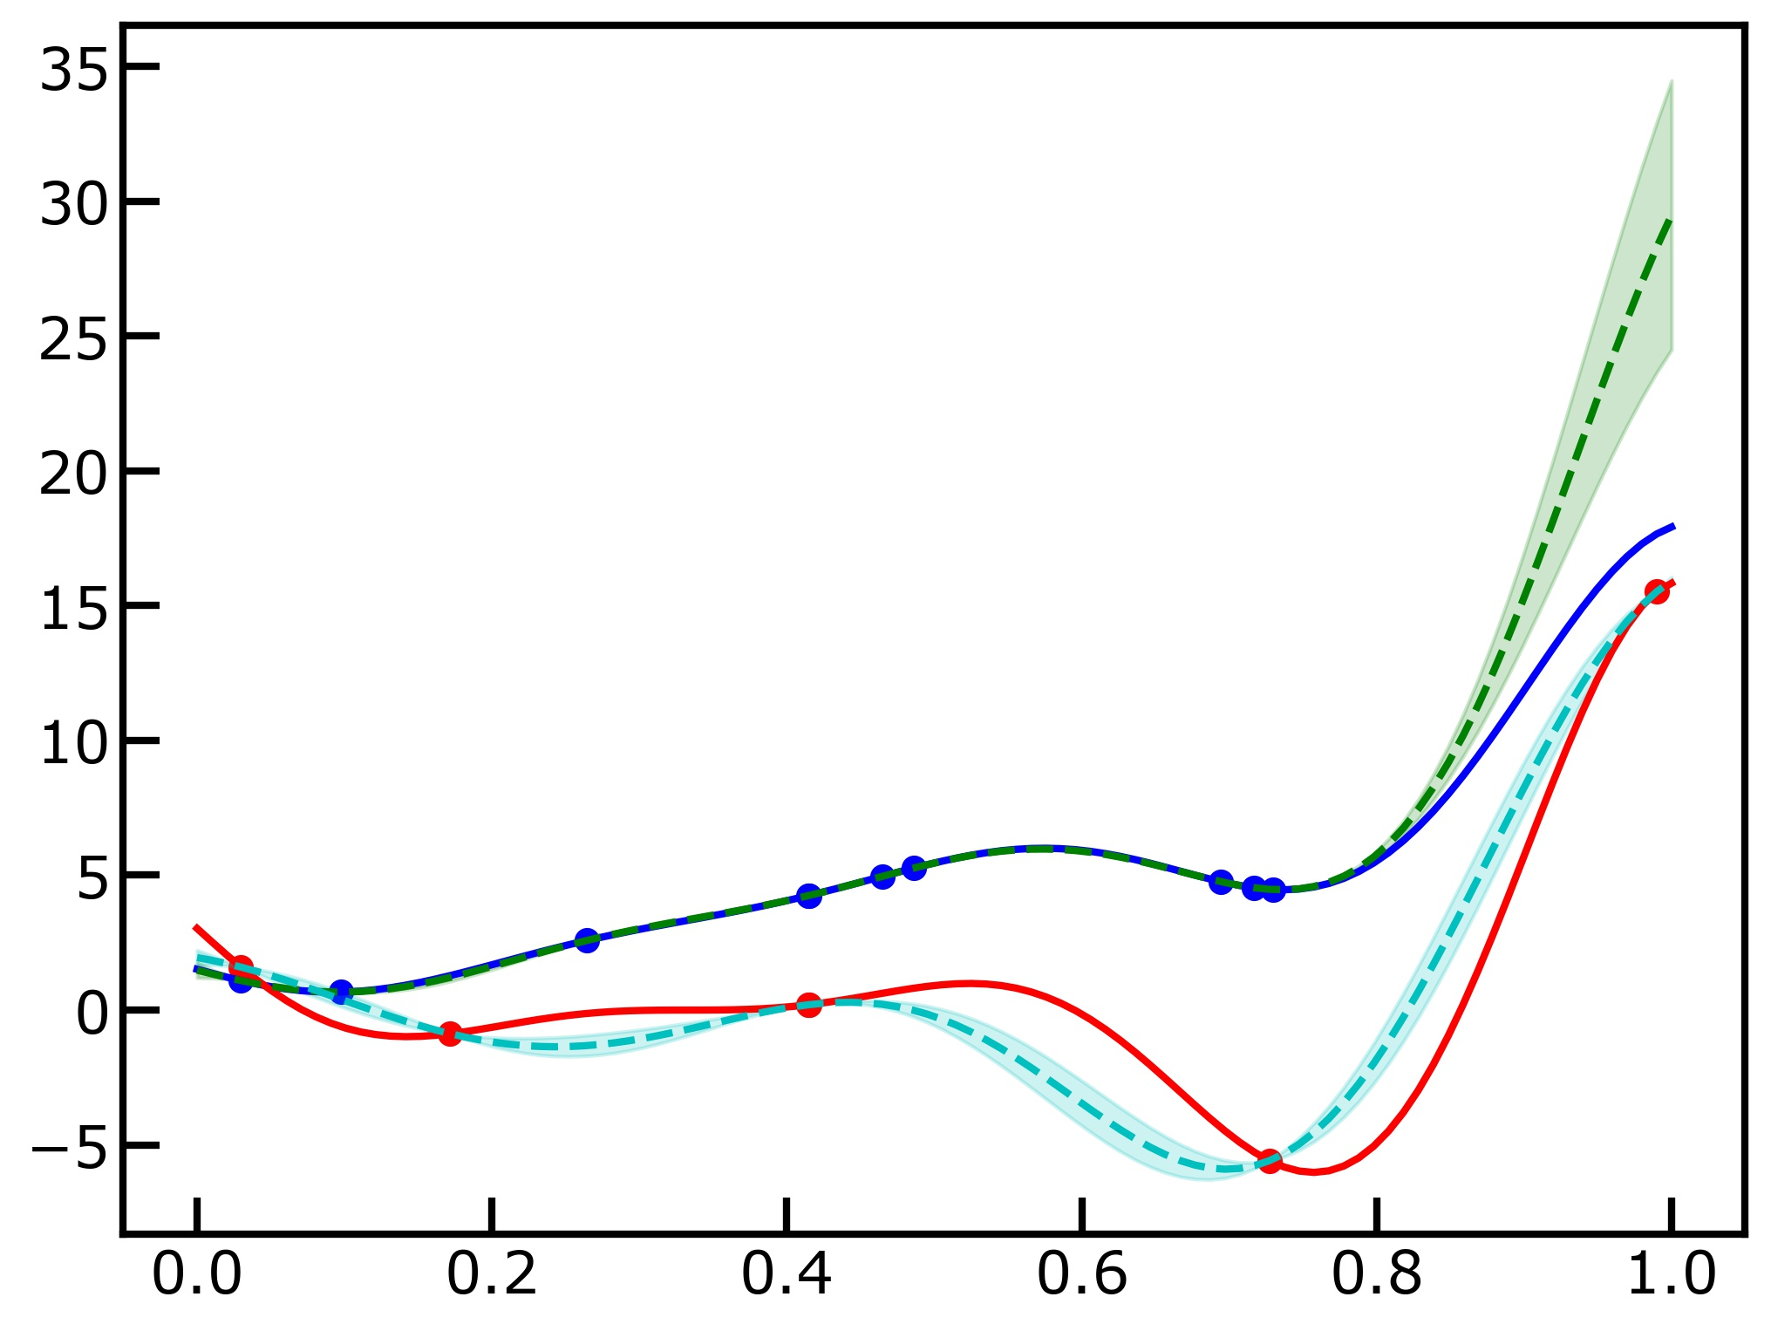


Machine Vision Module
Machine Learning Module
Gaussian Process Regression
Active Learning
Bayesian
Optimization
High Fidelity
Data
GPJet
Physics-based Modeling Module
Multi-fidelity Modeling
Gaussian Process Regression
Active Learning
Bayesian
Optimization
Low Fidelity
Data
Geometrical Pattern Model
Quasi-static fluid mechanical sewing machine model
Jet Model
Steady state fluid flow + heat transfer + viscoelasticity

